Slide 1

Supervisor meeting, Thursday Jun. 1st

Slide 2
Current Stage
Completed
topology generation
validation pipeline
simulation automation
reward framework
benchmark framework
In Progress
parallel simulation
RL training
grouped tree search
large-scale benchmarking

Slide 3
HPC / Container Infrastructure
Main problem:
LTspice is not available on Linux
Solutions attempted (In the span of the first 2 weeks after meeting)
Ngspice: too slow, different spice syntax which constantly crashes, no parallel simulation supported, only binary available, snellius provides no module for ngspice (or xyce)
Apptainer-based LTSpice container: Custom .def (developed by Bram Van de Berlo, HPC lab) which builds.sif execution image. Xvfb, wine required. Xvfb module is provided, however wine/ltspice.exe silently fails. Starts container, simulates single .net, returns .raw, closes container.
Sometimes running the container worked and finished approx in 20 secs. Sometimes fails silently, issue is almost never clear. Wine slow start also contributes to the issue.
Considered parallel approaches as well to separate multiple wine-prefixes: Isolated overlay images, container instances (remain open for the whole training process) assisted by threadpool execution. Regardless of these approaches, still fails silently.
Common with ngspice: Too slow (approximately 30 seconds per netlist!).
After many attempts decided to give up and move onto the next approach.
Notes:
Atakan’s part

Slide 4
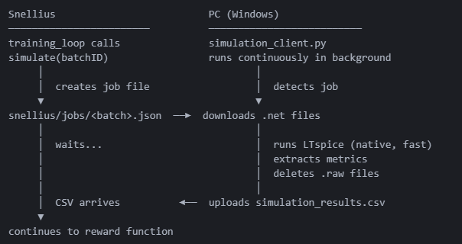
How we resolved the simulation bottleneck
Network-based approach
Using ssh, connect snellius to local windows pc/laptop.
RTT = 6-10 seconds per batch >>>> NGspice and Apptainer
Downside: PC needs to stay on the whole time.

Slide 5
SFT
Component | Choice
Base model | Qwen/Qwen3-14B (14.8 B parameters, bf16)
Method | LoRA via HuggingFace PEFT — no full fine-tune
LoRA rank / α | r = 16, α = 32, dropout = 0.05
Target modules | q_proj, k_proj, v_proj, o_proj, gate_proj, up_proj, down_proj (7 per layer)
Trainable params | 64.2 M / 14.83 B = 0.43 %
Loss | next-token cross-entropy
Hardware | 1 × NVIDIA H100 80 GB

Slide 6

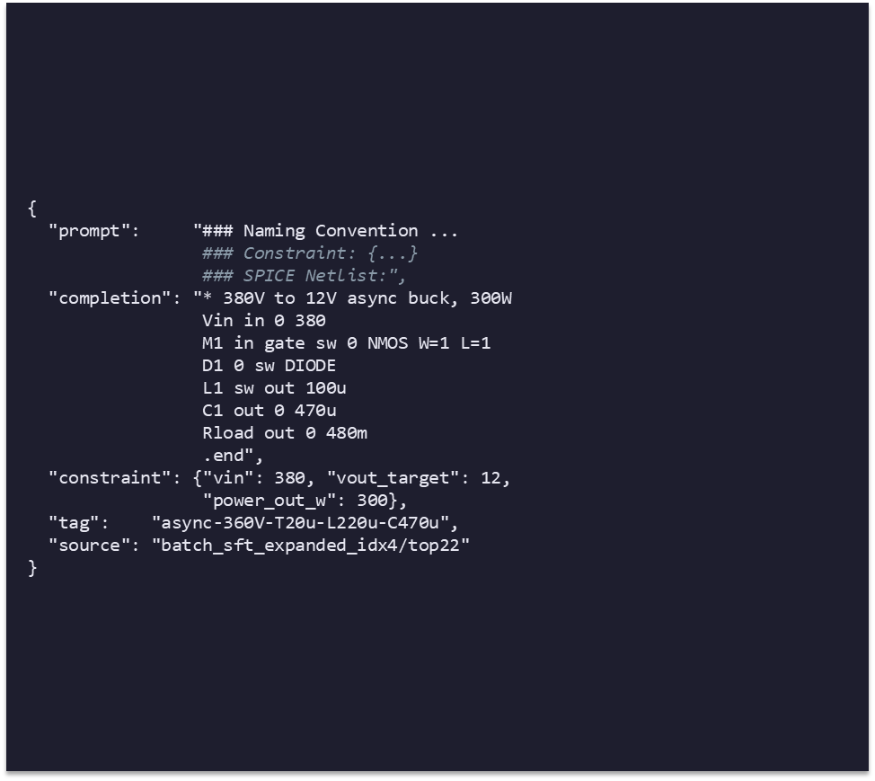
SFT Training data
Size & split
647 training + 71 validation = 718 total
10 % held out for val_loss probe
data/sft/sft_train.jsonl + sft_val.jsonl
Coverage (by topology family)
Buck / step-down: 12V→5V, 380V→12V, 400V→24V, 208V→3.3V
Boost / step-up: 12V→380V, 9V→220V, 5V→208V, 12V→400V
Buck-Boost / SEPIC: wide-input, telecom, grid stabilizer
13 constraint slots × ~50 valid candidates each

Slide 7
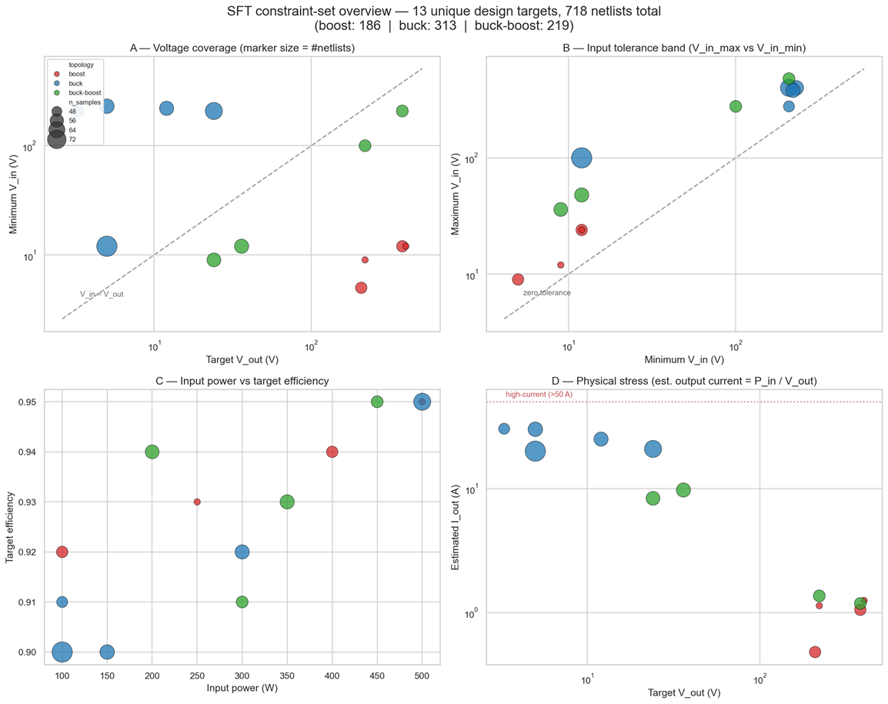
SFT Dataset coverage (constraint space)
A V_out vs V_in: above diagonal = step-down (buck), below = step-up (boost)
B input tolerance: farther from diagonal = wider input swing (harder)
C power vs efficiency: all in 100–500 W / 0.90–0.95
D est. current = P_in/V_out: all < 50 A → physically sane

Slide 8
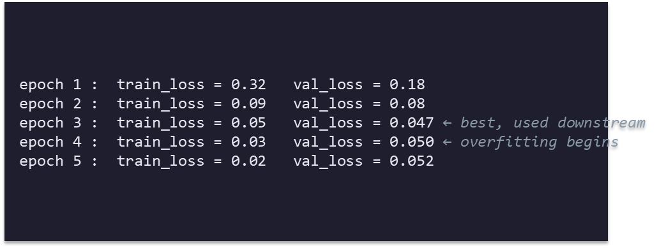
Training recipe & loss curve
Hyperparameter | Value
Epochs | 5
Batch size | 2 (OOM-safe)
Sequence length | 1024 tokens
Optimizer | AdamW, lr = 2 × 10⁻⁴
Gradient clip | max_norm = 1.0
Scheduler | constant (no warmup — short run)
Checkpoints | save after every epoch + final/

Slide 9
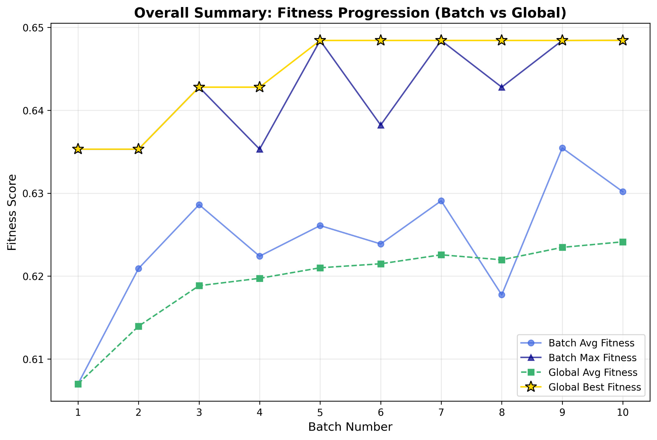
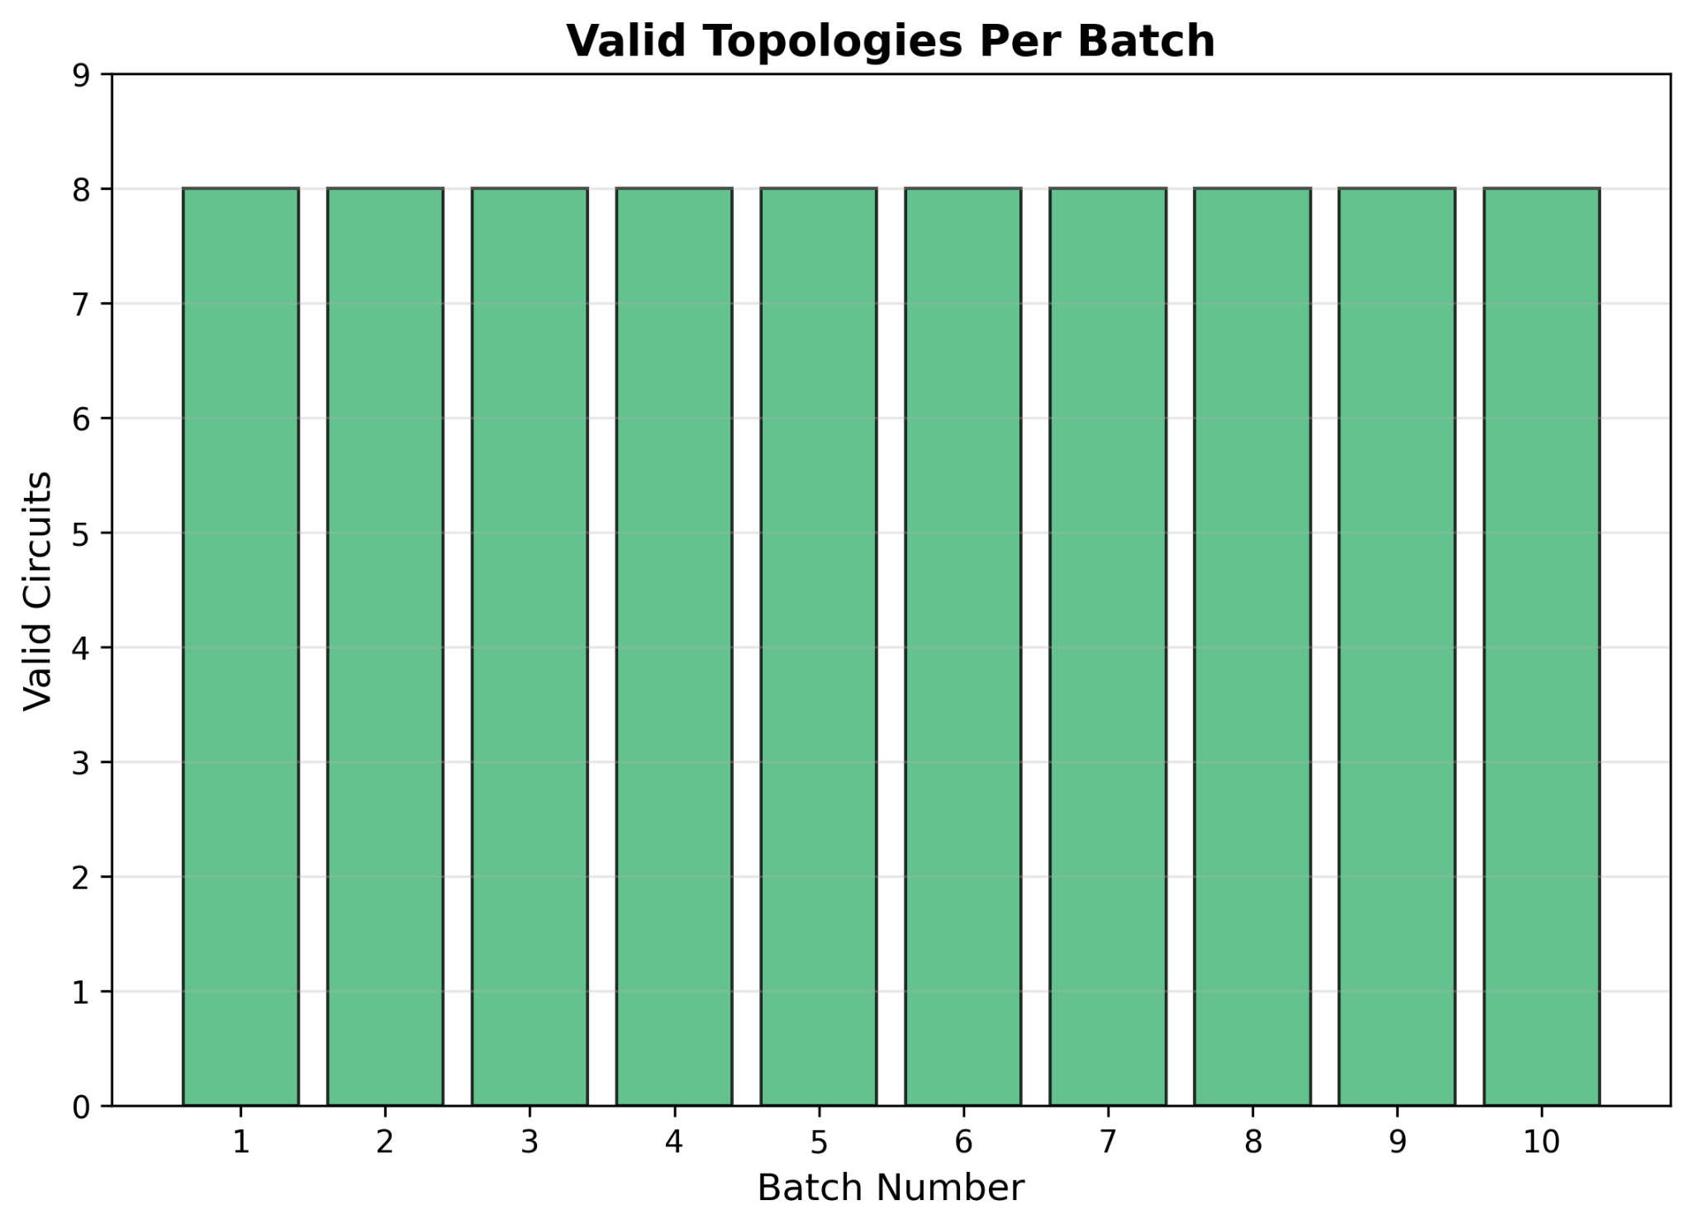
Run metrics
Zycos 005/ Run 8
Fitness
Voltage
Efficiency
Volume
Components
Validity rate
Notes:
Chris part

Slide 10
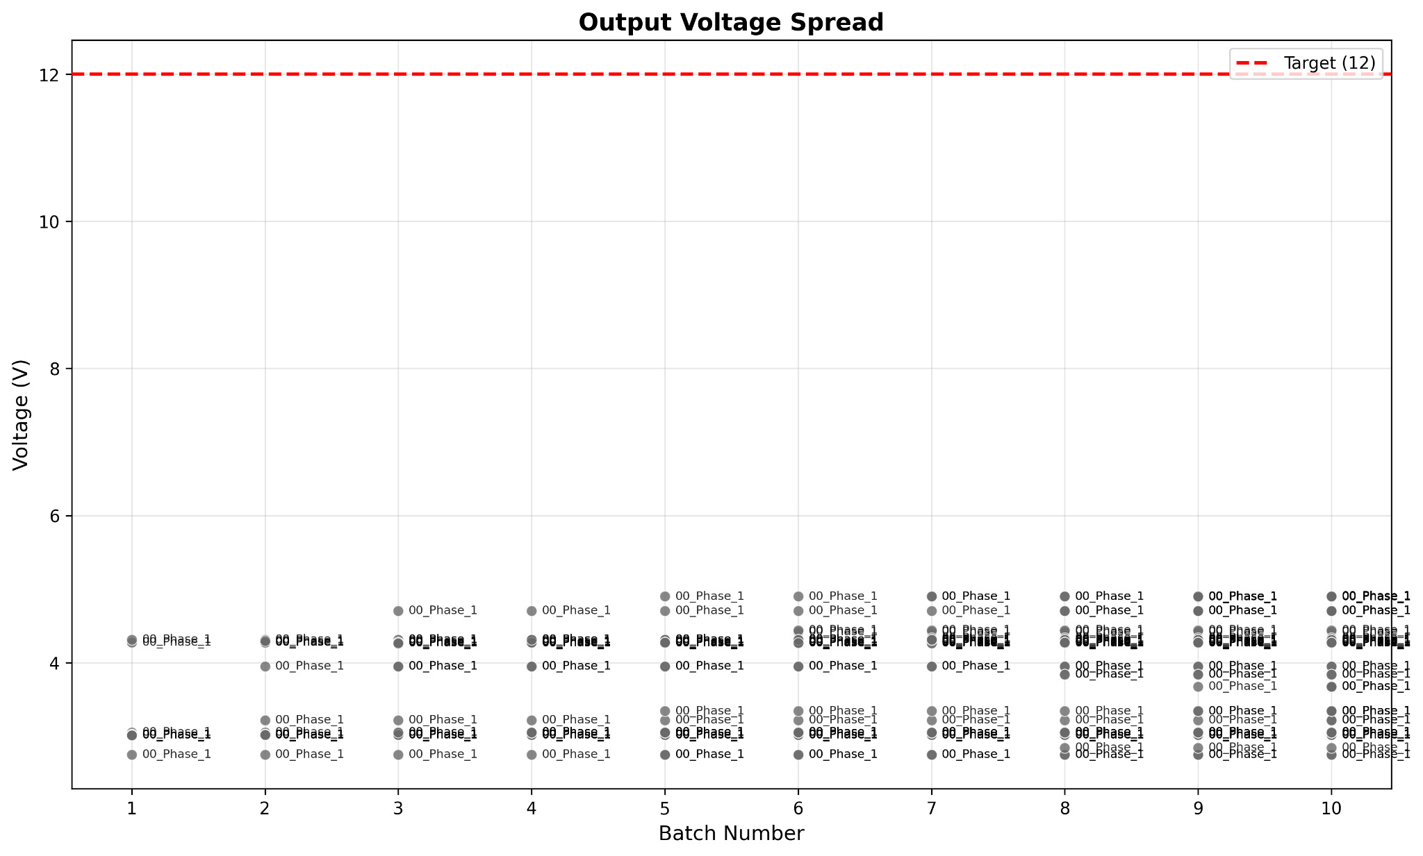
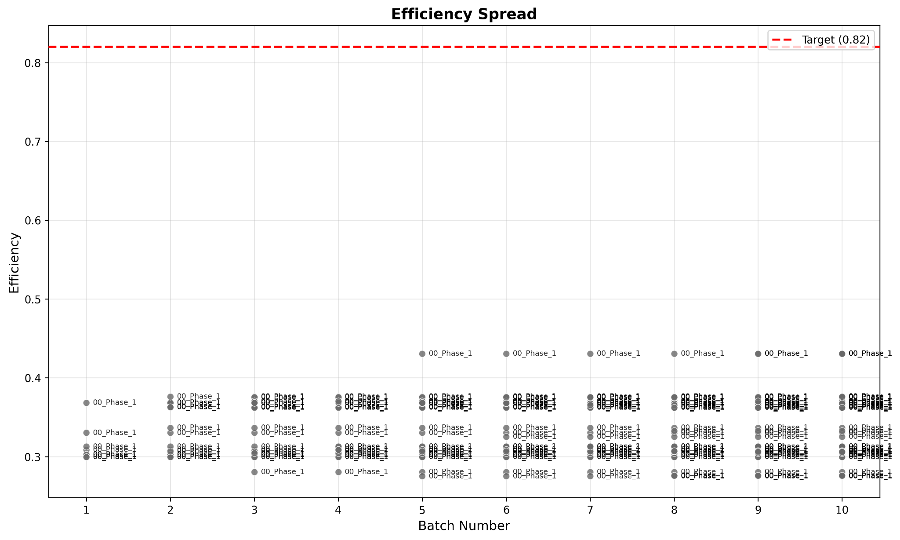
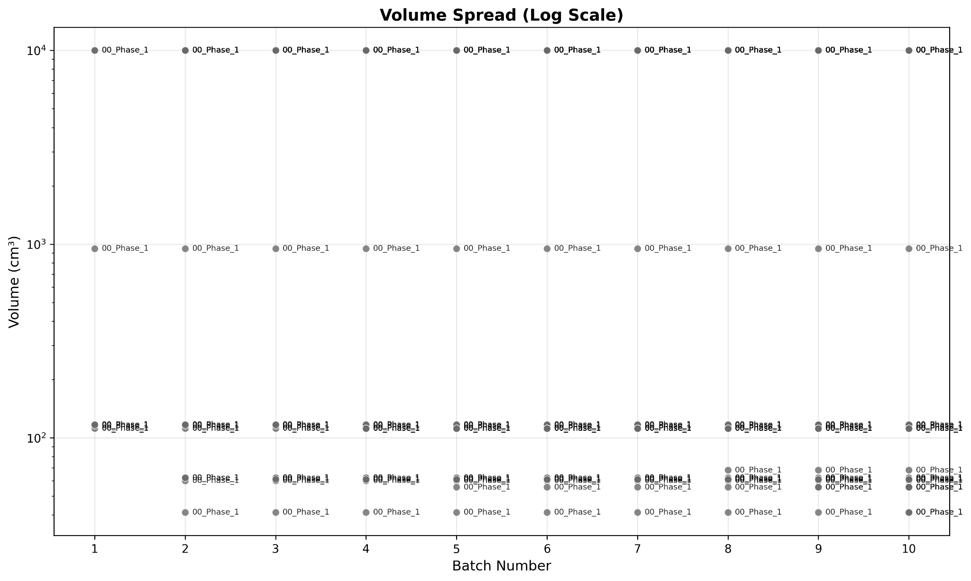
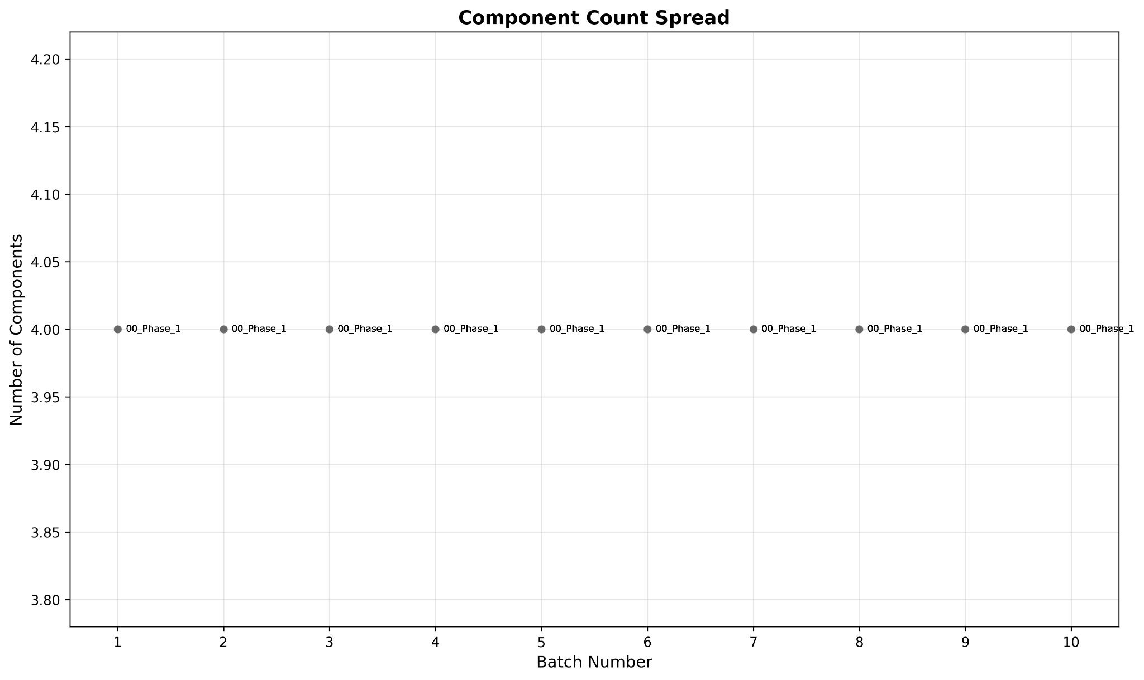
Run metrics
Notes:
Chris part

Slide 11
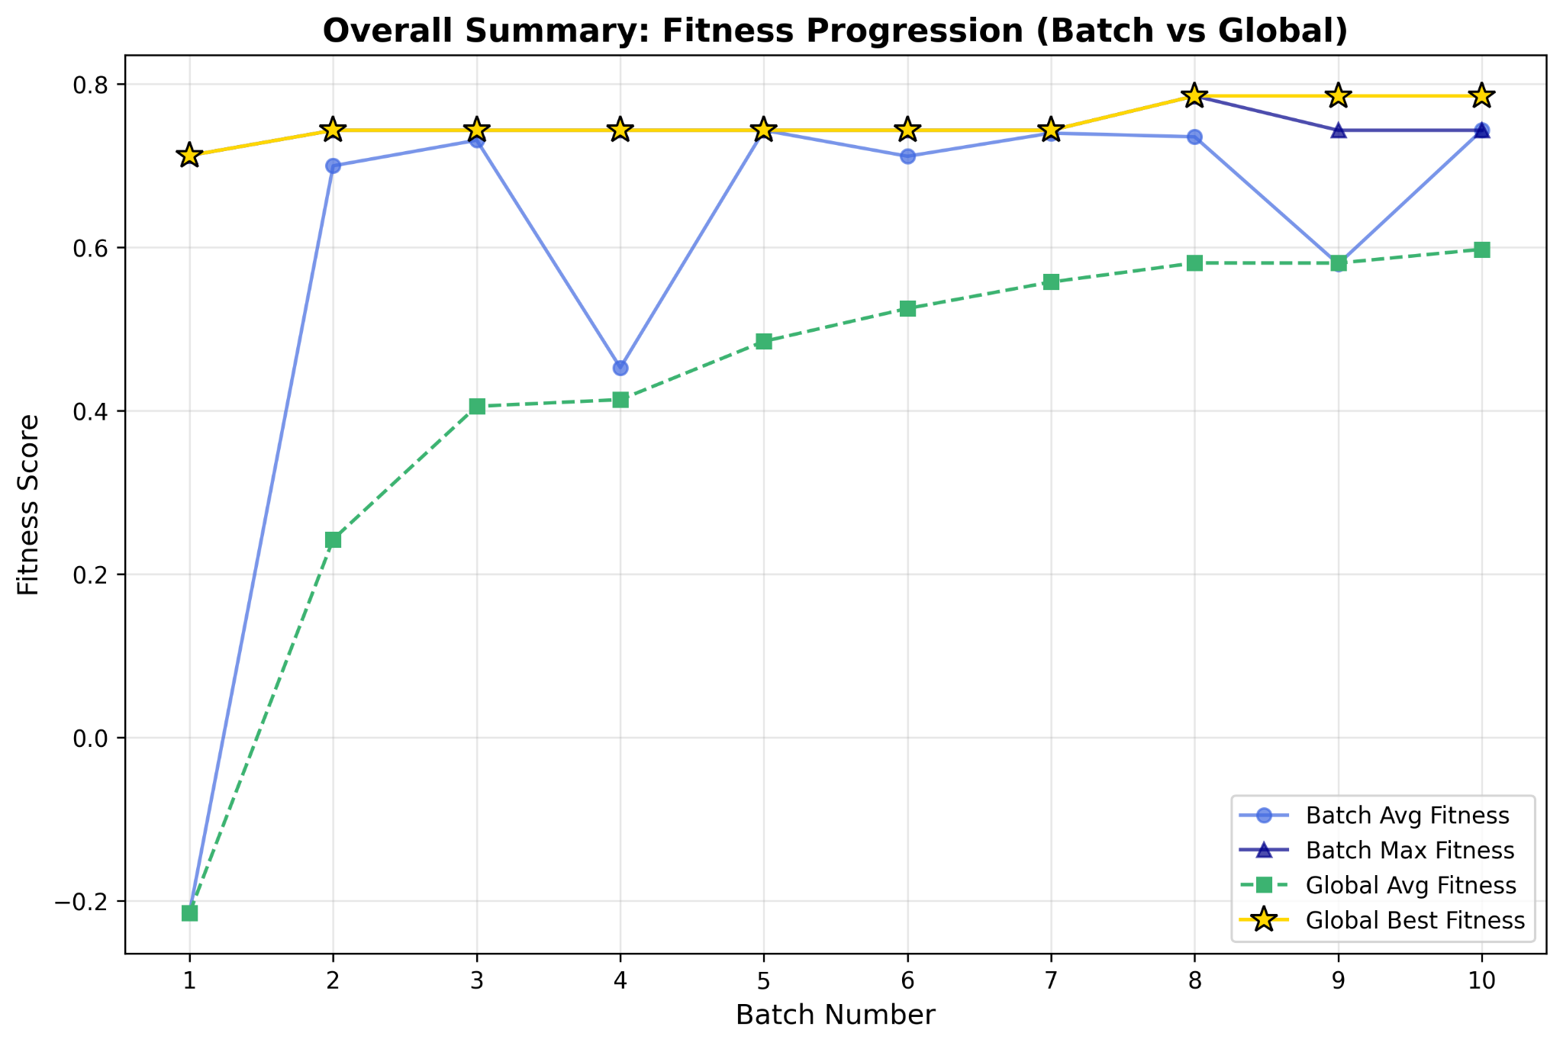
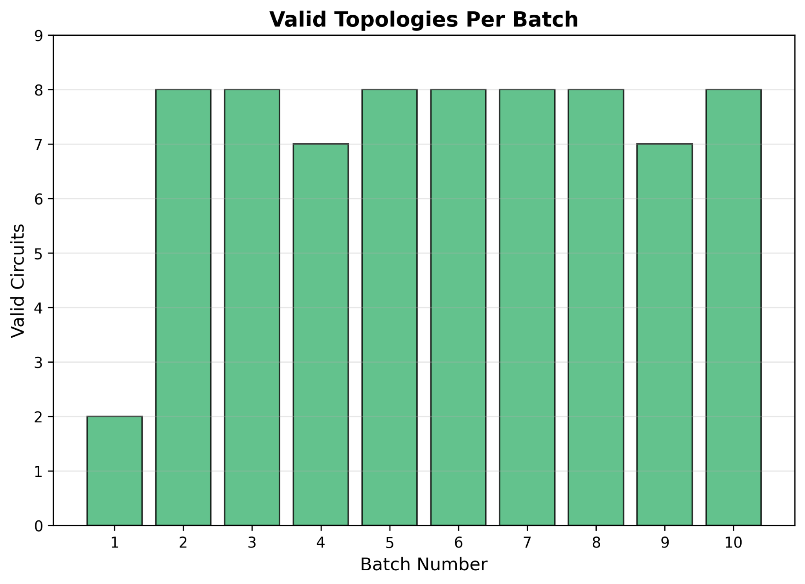
Run metrics
Zycos 005/ Run 9
Fitness
Voltage
Efficiency
Volume
Components
Validity rate
Notes:
Chris part

Slide 12
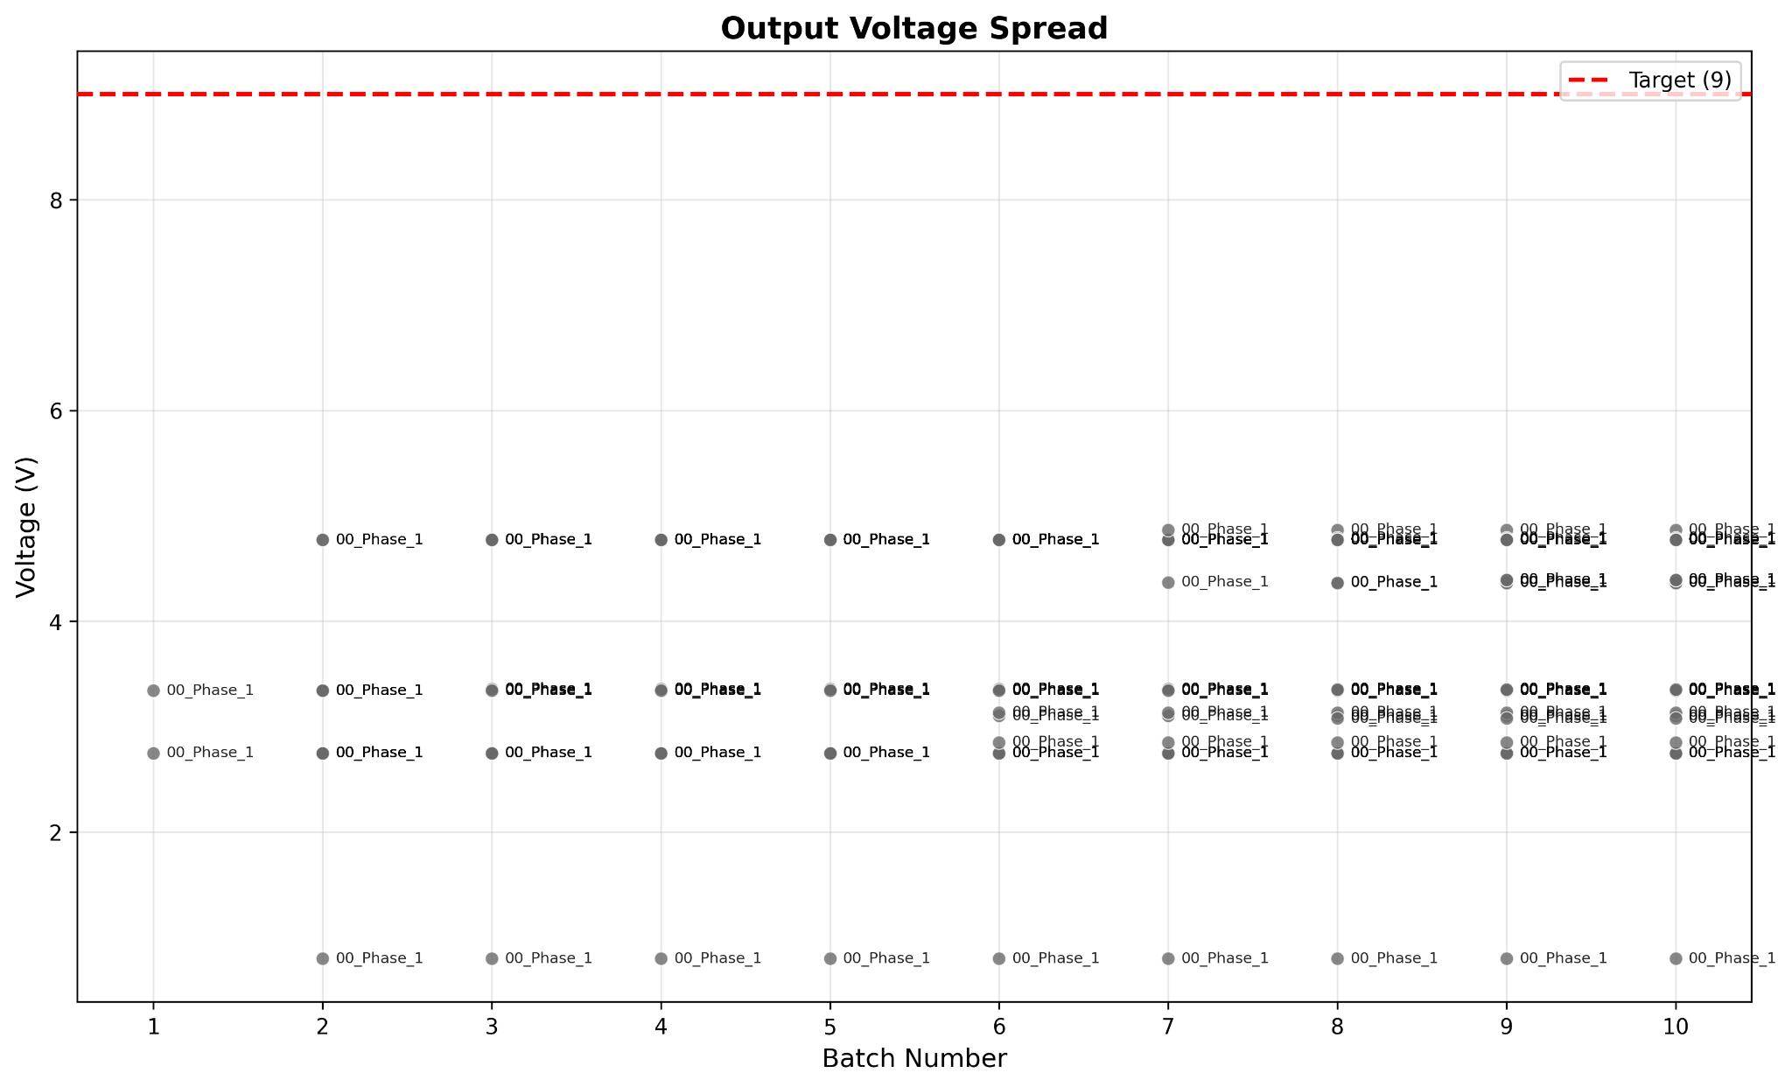
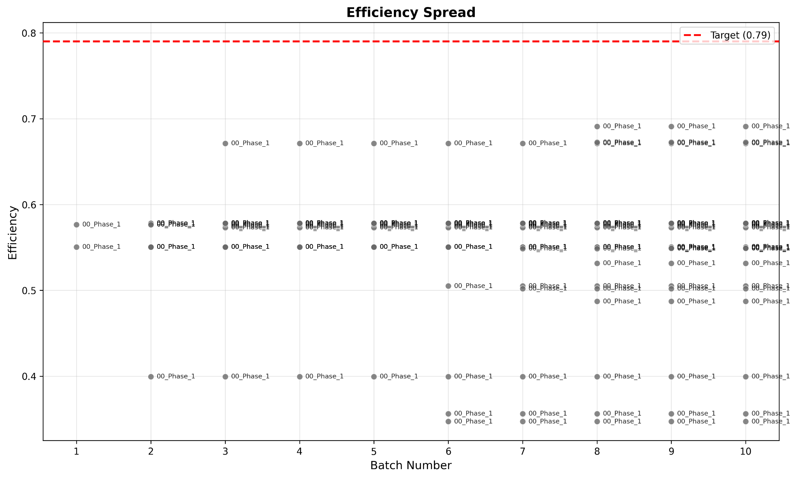
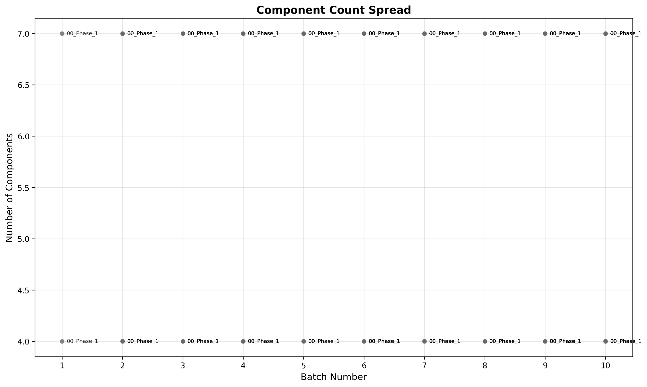
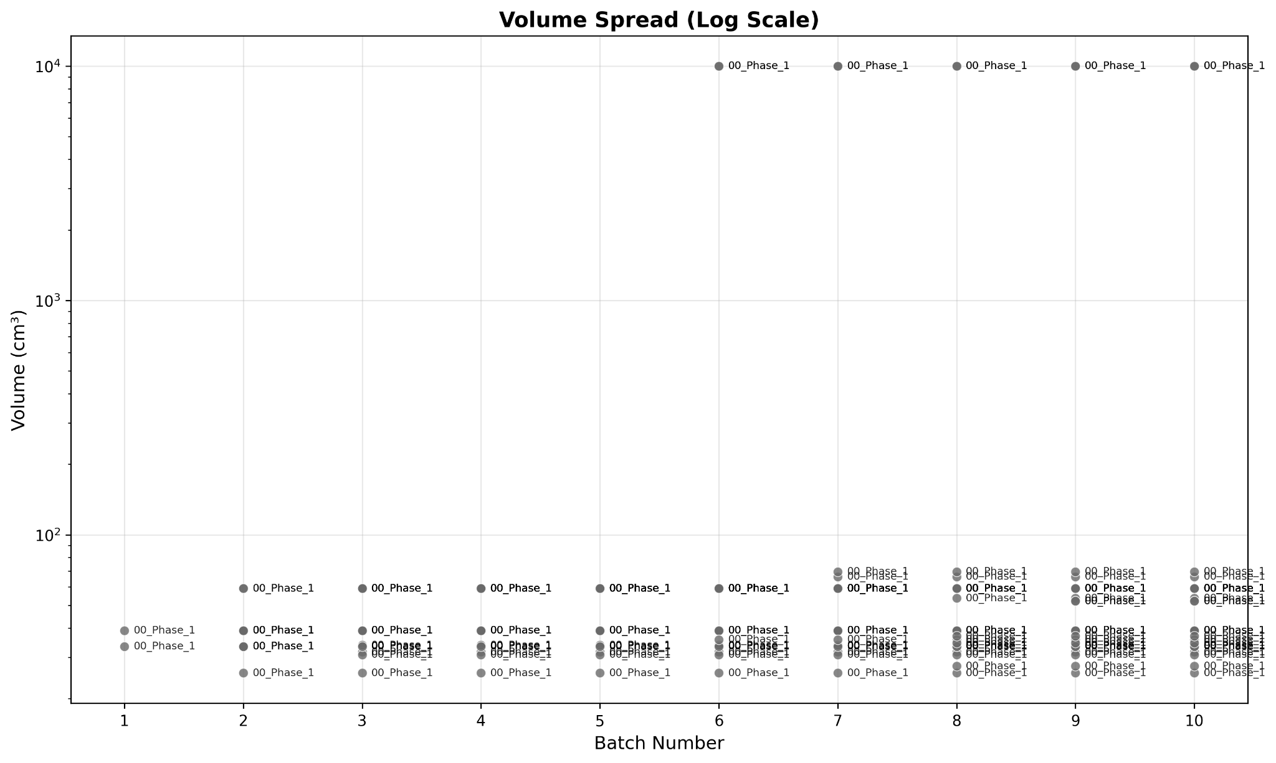
Run metrics
Notes:
Chris part

Slide 13
Benchmark & Evaluation Framework
Key goals
fair model comparison
reproducible evaluation
topology evolution tracking
Added features
multi-trial evaluation
statistical analysis
normalized metrics
topology lineage tracking
Notes:
Chris part

Slide 14
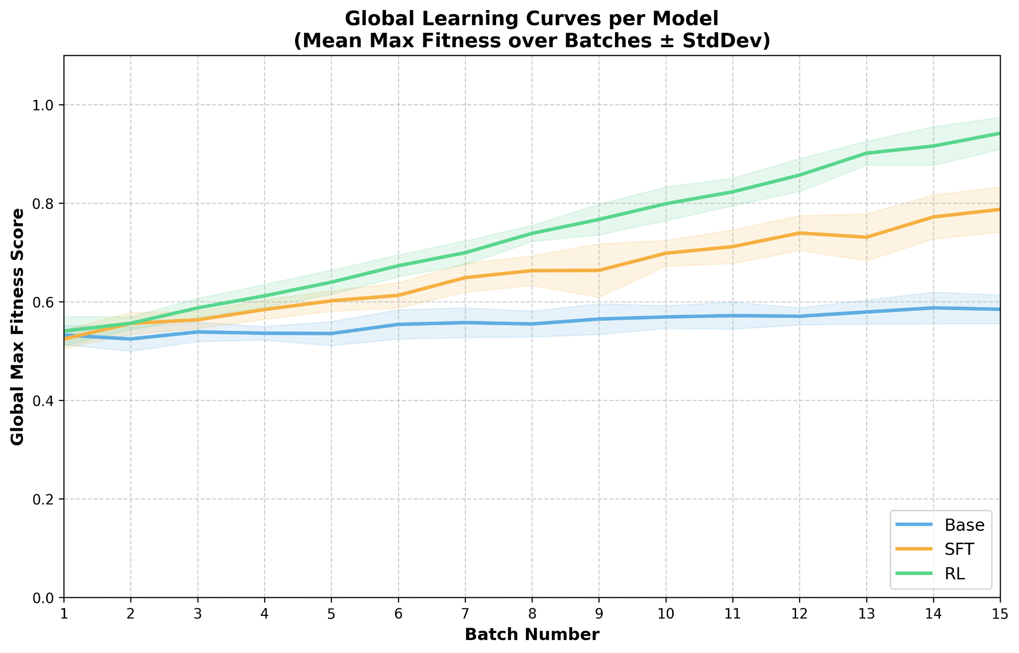
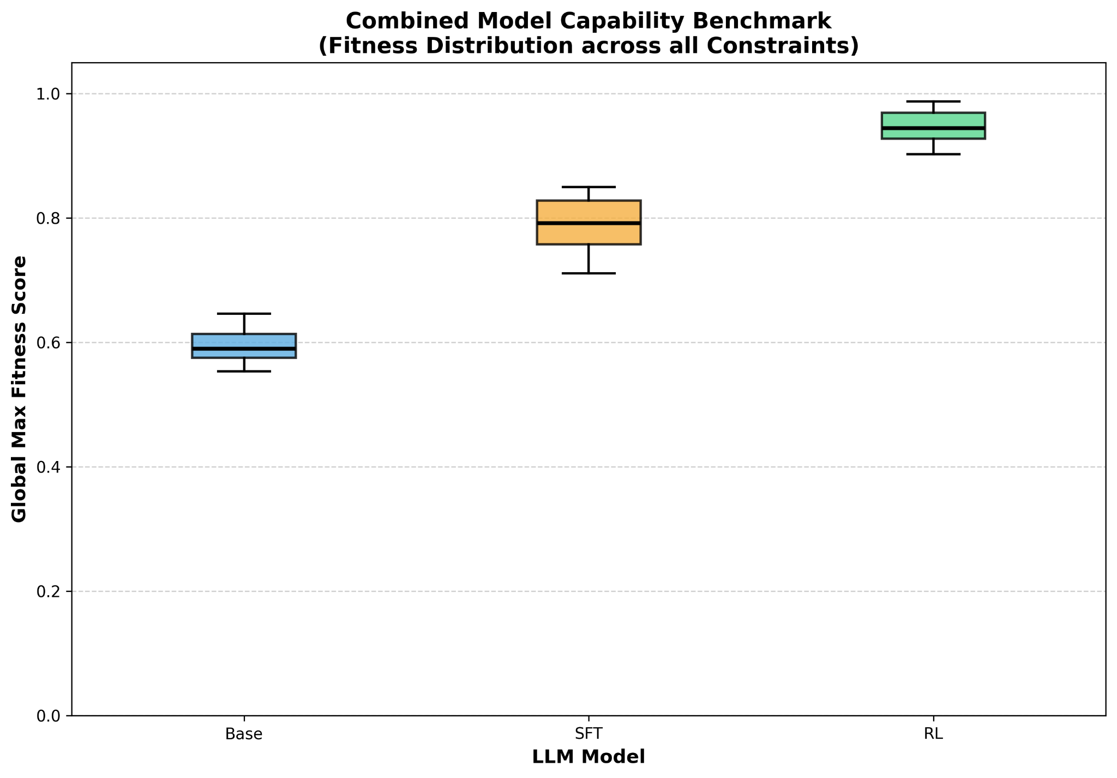
Benchmark & Evaluation Framework
Notes:
Chris part

Slide 15
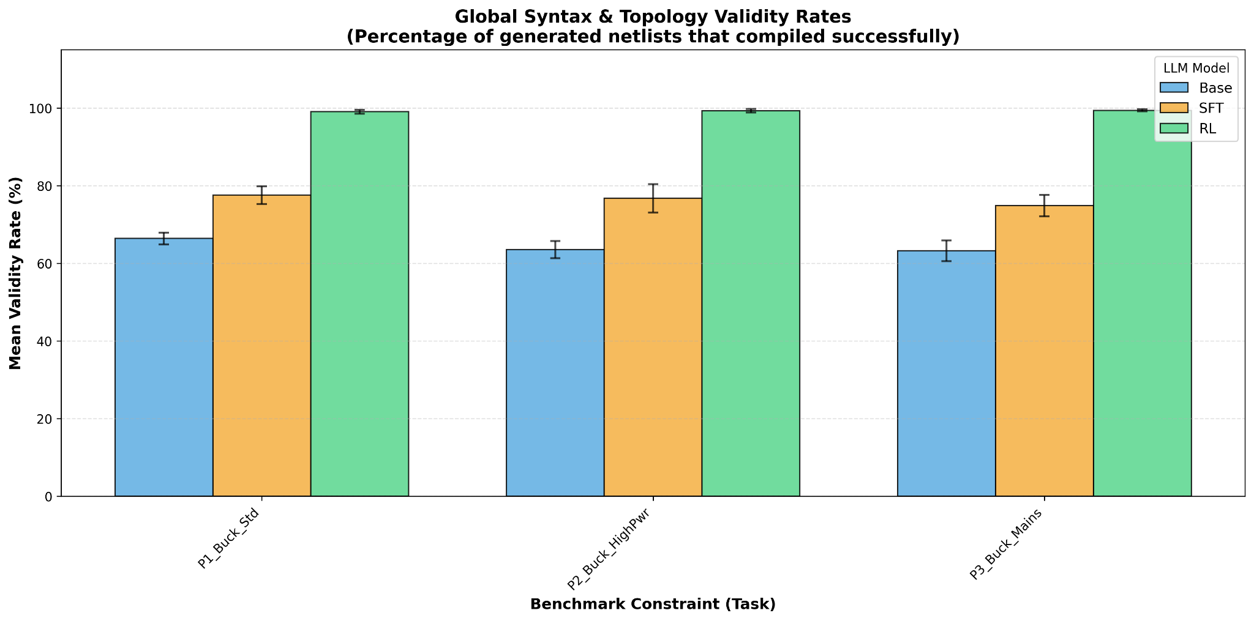
Benchmark & Evaluation Framework
Notes:
Chris part

Slide 16
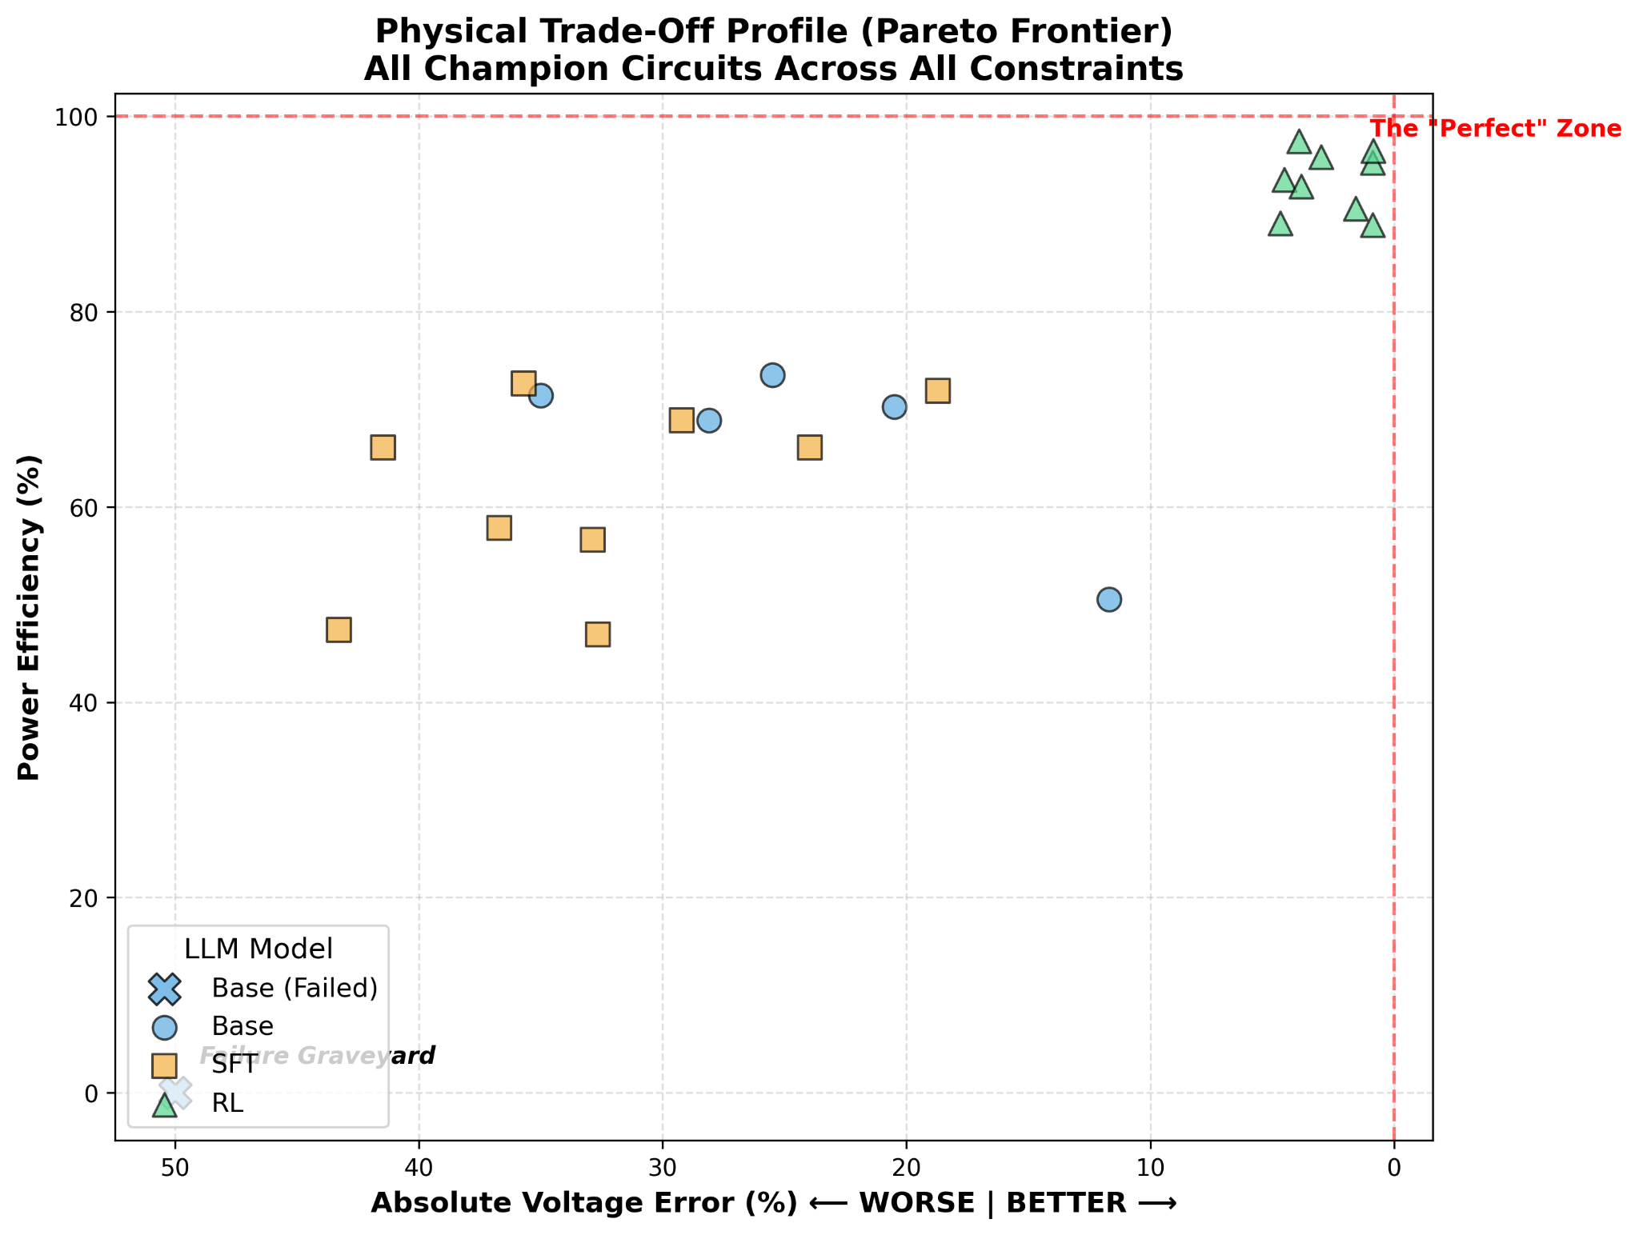
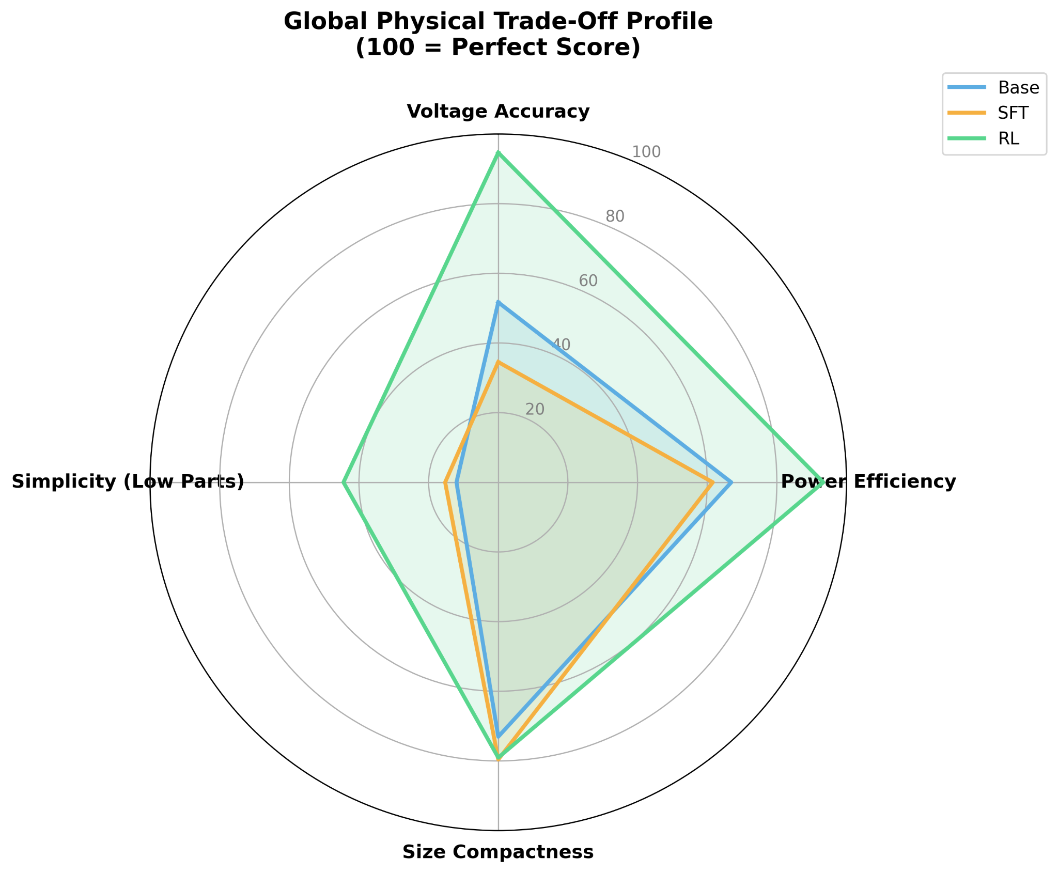
Benchmark & Evaluation Framework
Notes:
Chris part

Slide 17
Epsilon-Greedy Top-K Softmax Search
Exploitation
Rank all historical candidate
Sample from Top-K using softmax probability
Exploration
with probability ε, sample from long-tail candidates
keeps low-ranked but diverse topologies alive
Current setup
Top-K = 8
ε = 0.15
temperature = 0.1 (controls how strongly we favor the best candidate)
Notes:
（Depth was not a reliable indicator of circuit quality, so parent selection was simplified to fitness-based ranking while keeping depth only for lineage tracking.） We considered using pure softmax over the entire historical database.
However, as the database grows, many low-performing circuits remain in the long tail.
Even though their probabilities are small, collectively they still receive a significant amount of sampling budget.
As a result, the search may repeatedly evaluate poor circuits.
Therefore, we restrict most sampling to the Top-K candidates and only reserve a small ε probability for exploration.

Slide 18
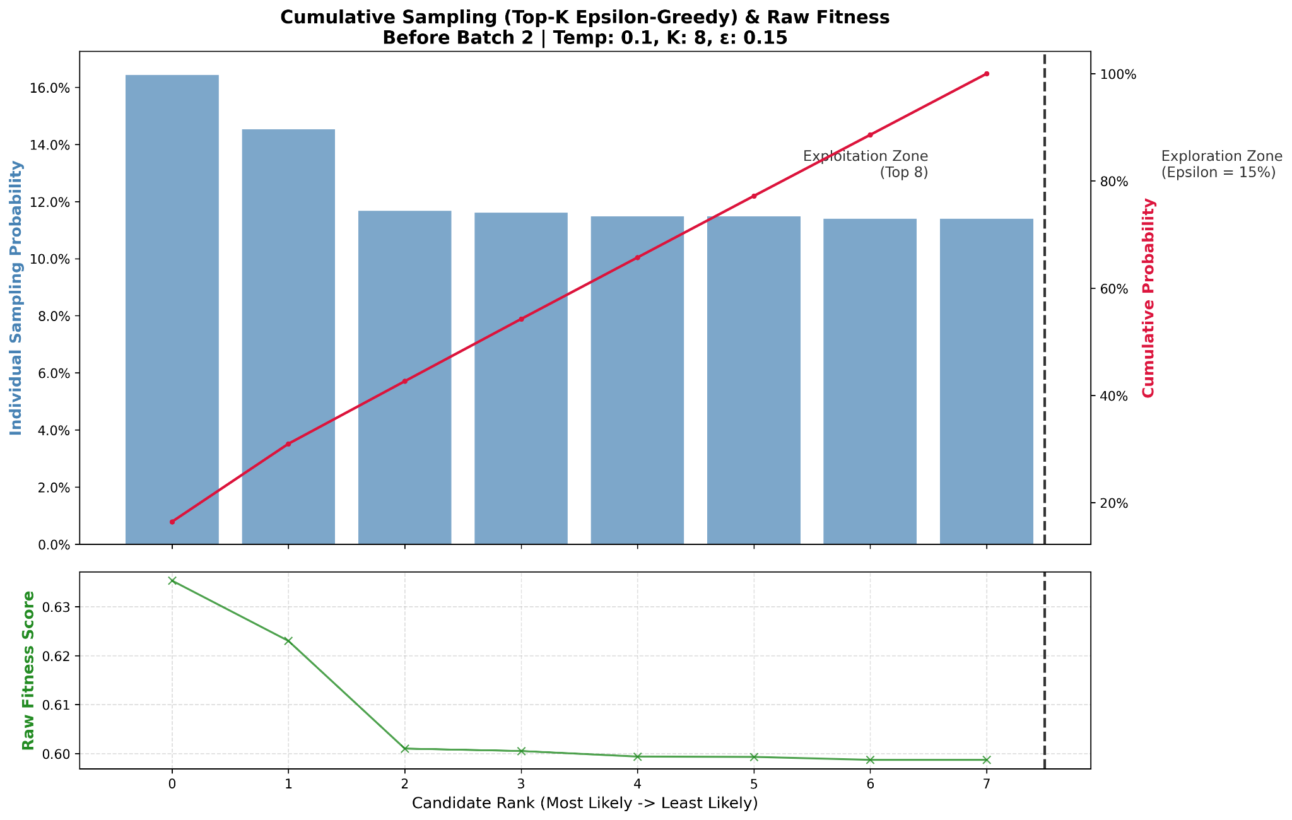
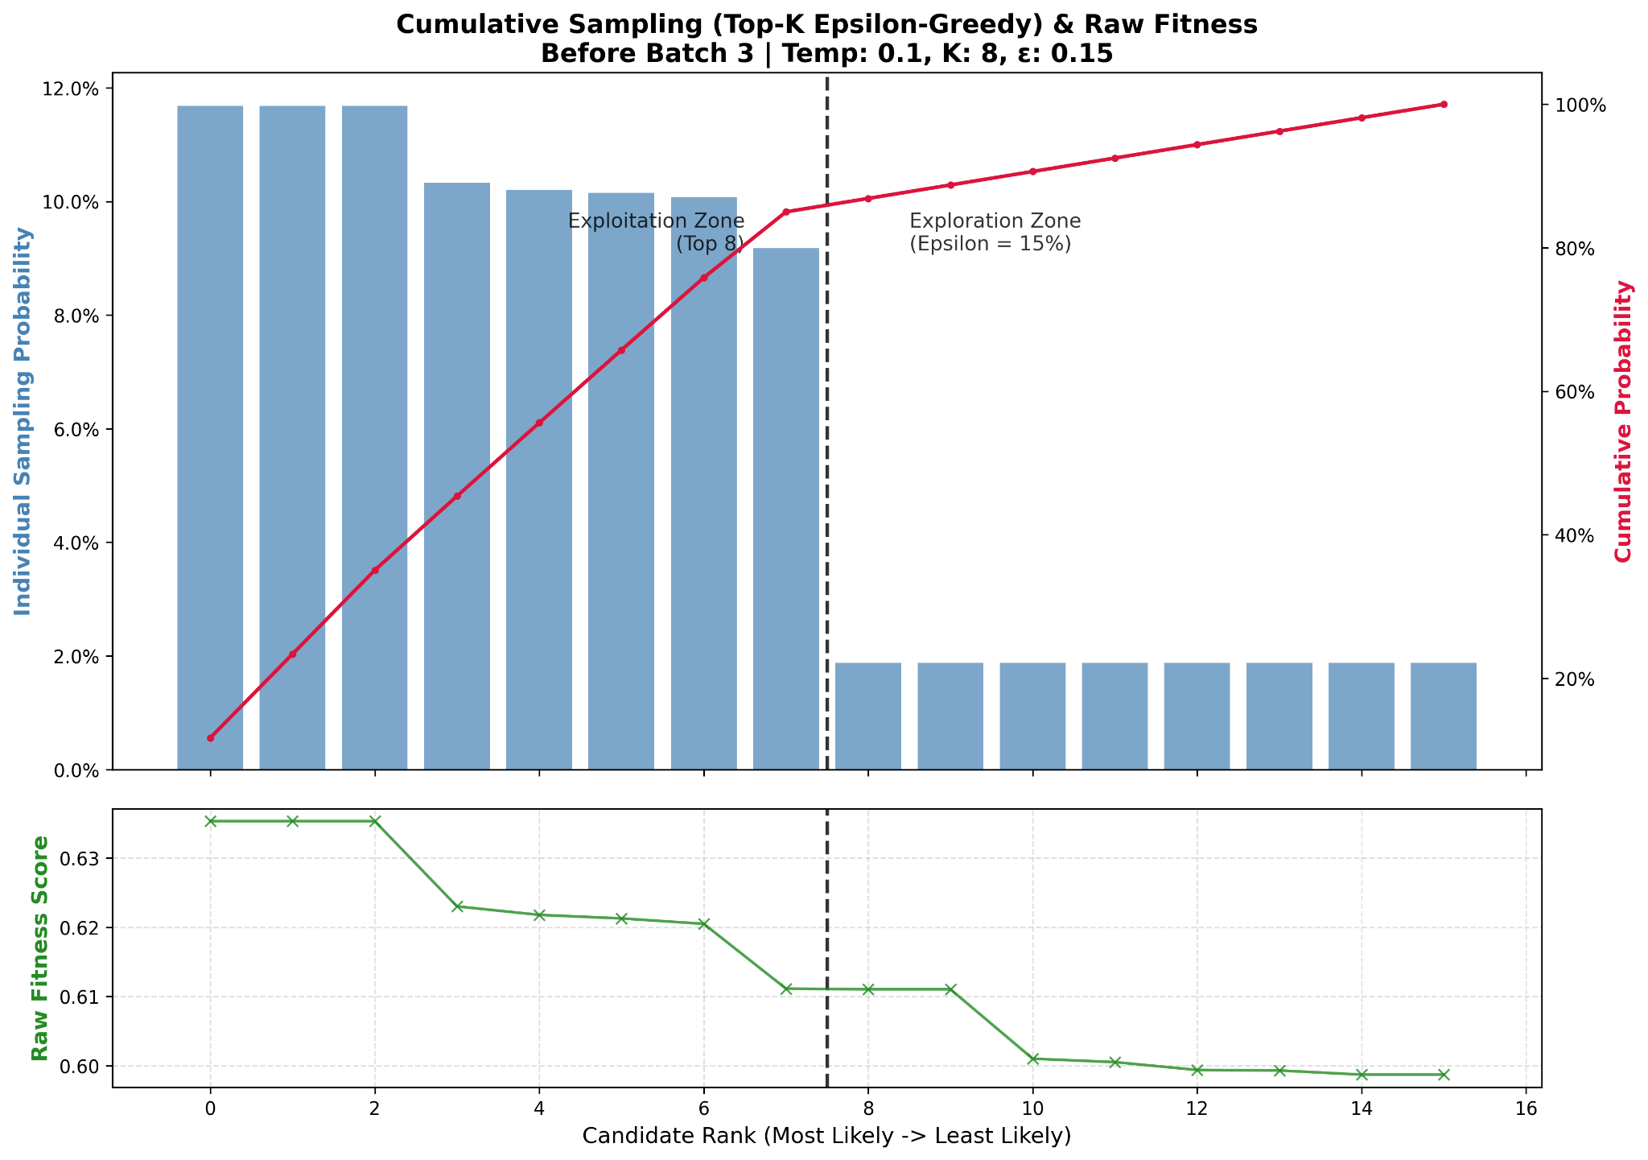
Epsilon-Greedy Top-K Softmax Search
Batch 2
Batch 3
Notes:
Batch 2
At the beginning of training there are only a few evaluated circuits.
Therefore almost all candidates are inside the Top-K region.
Batch 3
As more circuits enter the historical database, the separation between exploitation and exploration becomes visible.
The Top-K region still receives most probability mass, while the long tail only receives the exploration budget.

Slide 19
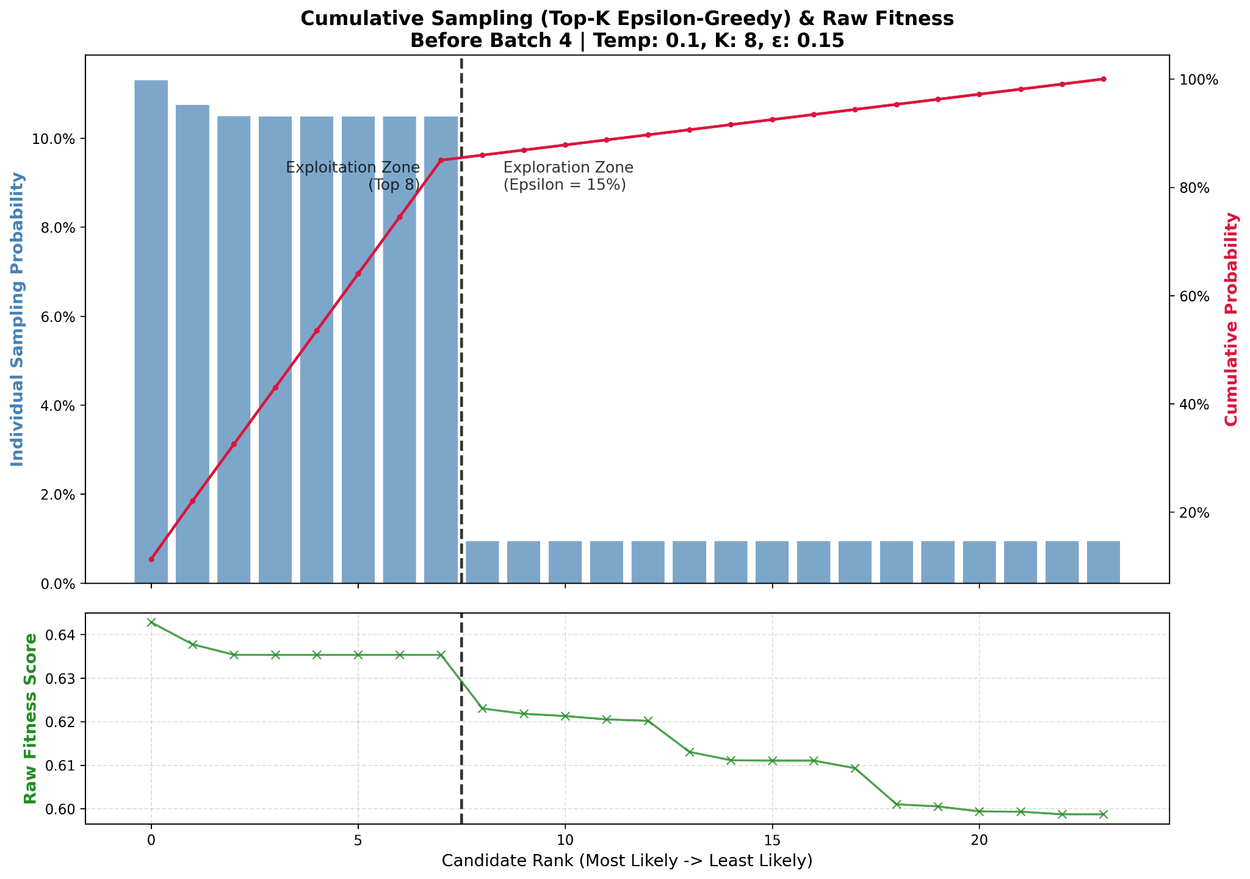
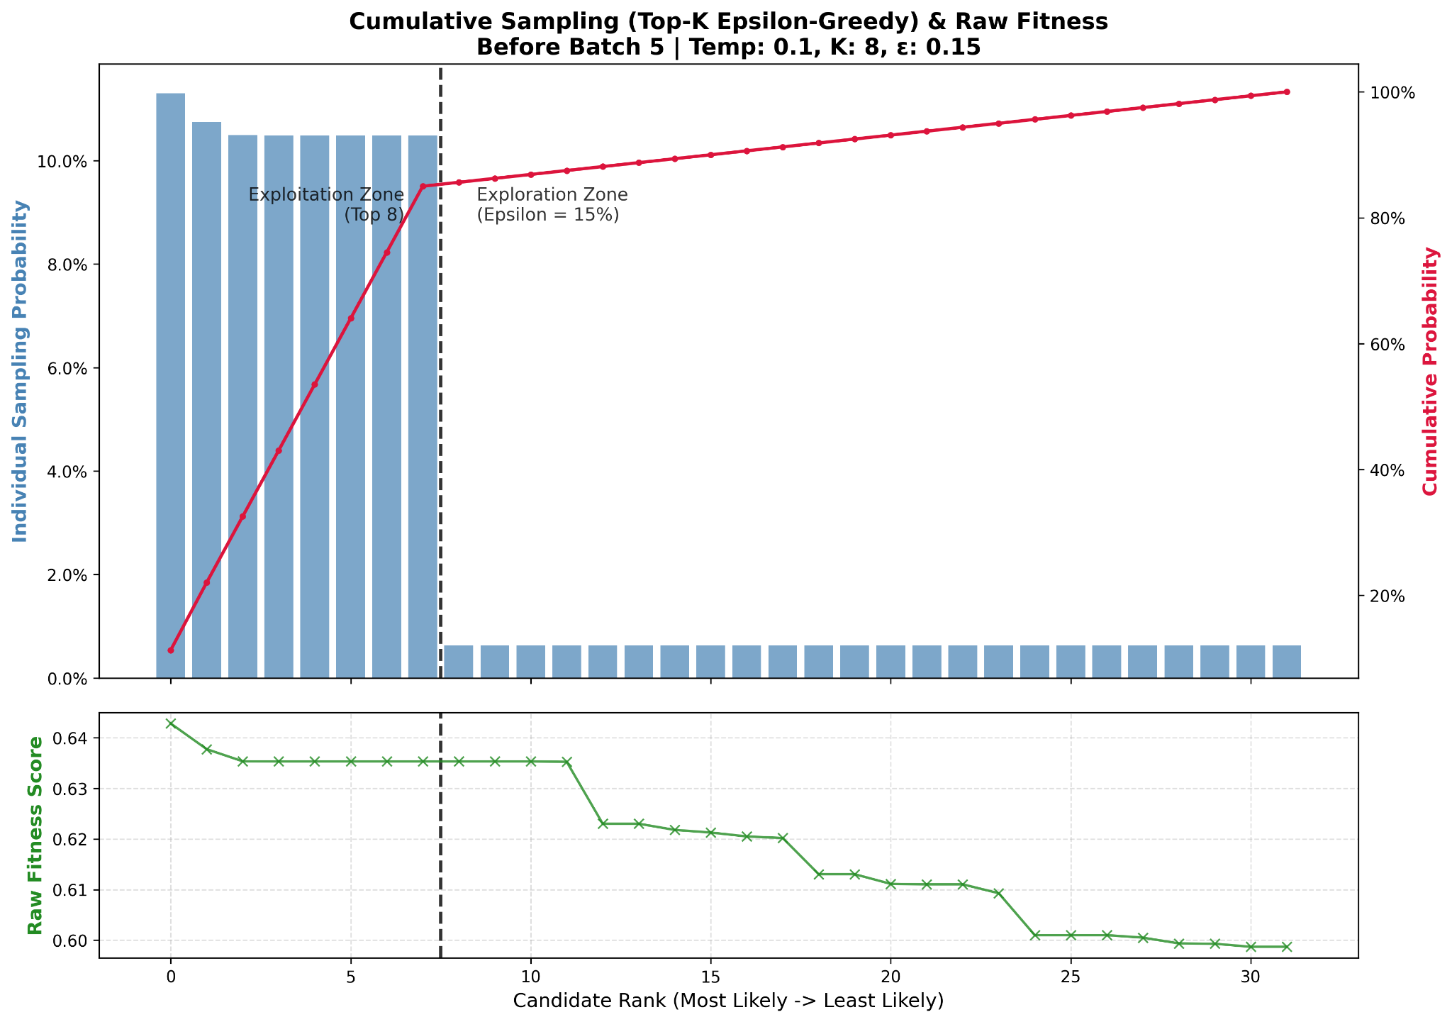
Epsilon-Greedy Top-K Softmax Search
Batch 4
Batch 5

Slide 20
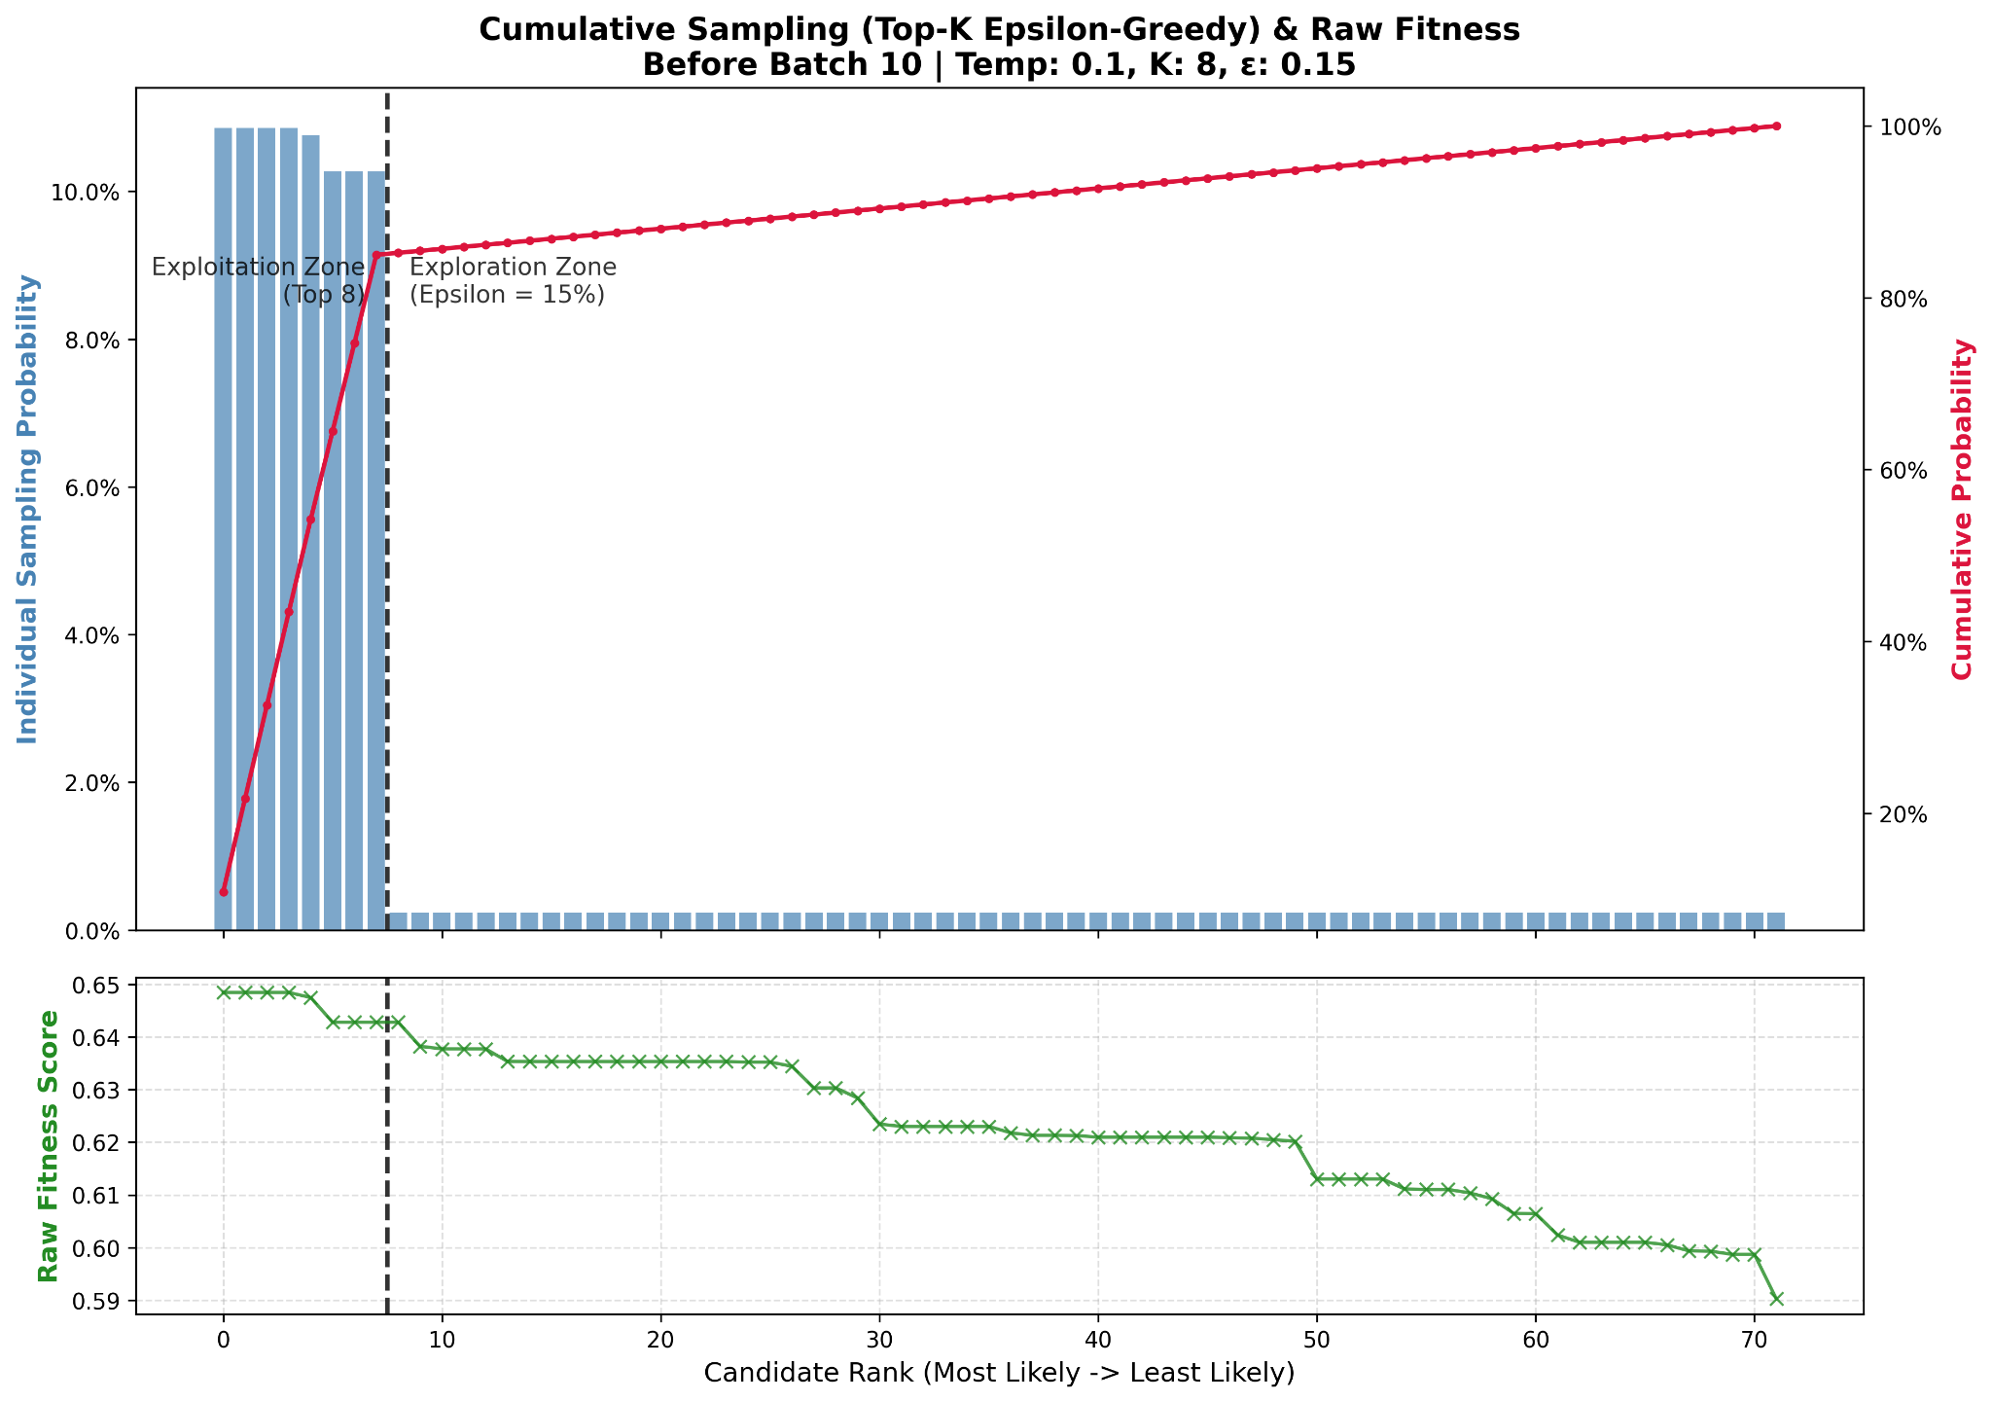
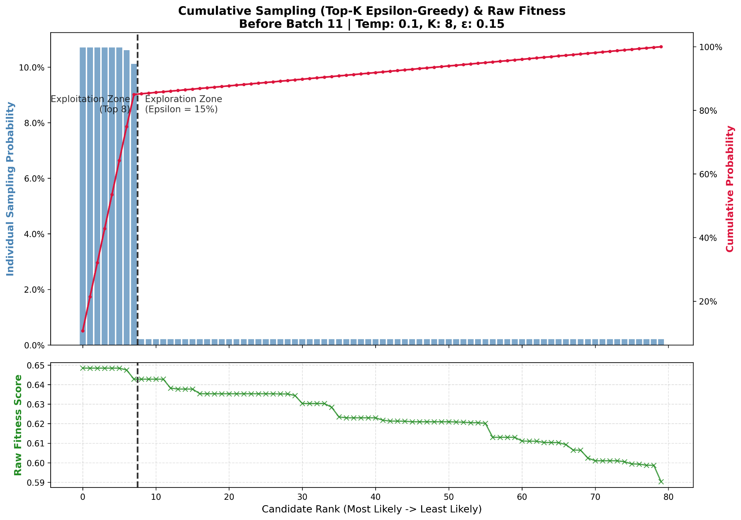
Epsilon-Greedy Top-K Softmax Search
Batch 10
Batch 11
Notes:
By Batch 10 and Batch 11 we observe that the probability distribution inside Top-K becomes almost flat.

Slide 21
RL Tree Search Refactor
Previous issue
Limited topology diversity
Repeated topology collapse
Unstable parent selection
Current solution
store all evaluated topologies in history_db.json
track parent_id and depth for lineage analysis
select parents from the full history using Top-K softmax
use ε-greedy long-tail sampling to preserve explorati

Slide 22

Results
3 constraint sets, easy/medium/hard.json, 10 runs per .json and 10 iterations per run. Making use of curriculum learning:
Zycos-5, uses weights of sft-2, trained on constraints_easy.json.
Zycos-6, uses weights of Zycos-5, trained on constraints_medium.json.
Zycos-7, uses weights of Zycos-6, trained on constraints_hard.json.
So far:
Zycos 5: Avg fitness score = 0.857
Zycos 6: Avg fitness score = 0.685 (Crashed for run 10), tuning parameters may help.
Zycos 7: Not run yet
Benchmark for all 3 (Base vs SFT vs Zycos 5/6/7) is not done yet.

